Slide 1
Applied Data Science Capstone by IBM/Coursera
Avani Bhatnagar
August 11, 2021

Slide 2
Business Problem
Location is very important when it comes to opening a restaurant. If a family wants to open up a restaurant in a city, they need to know different things about the location to be able to strategically select the correct neighborhood which will attract the most crowd, is affordable to open up a restaurant at, has lesser competition, population etc.

Slide 3
Data Acquisition and Cleaning
New York Data: We use this dataset: https://en.wikipedia.org/wiki/New_York_City to get information about the various New York neighborhoods which will help us explore and decide the best location for an Indian restaurant.
Foursquare API: We use Foursquare API to get various restaurants in New York such as Indian Cuisine. This will help the business get an idea of what's the best location to open their restaurant in terms on relative competition in the same business.
Geospatial data - We use https://data.cityofnewyork.us/City-Government/Borough-Boundaries/tqmj-j8zm to get the location details of New York - it gives us the Latitude and Longitude values for each Borough in New York. This will be greatly helpful in generating maps and visualizing the overall results.
Demographic data - We use https://en.wikipedia.org/wiki/Demographics_of_New_York_City to get the demographic data for NYC's jurisdiction.

Slide 4
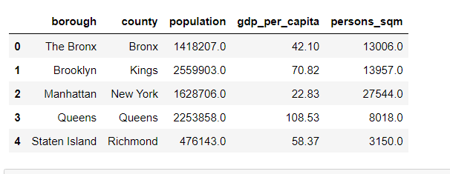
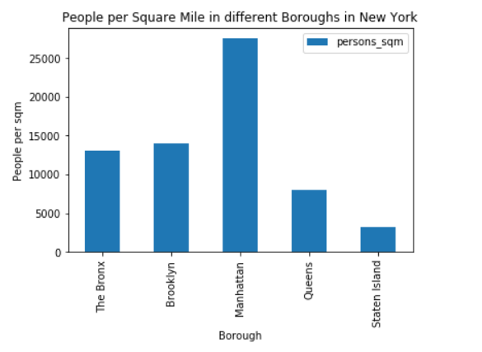
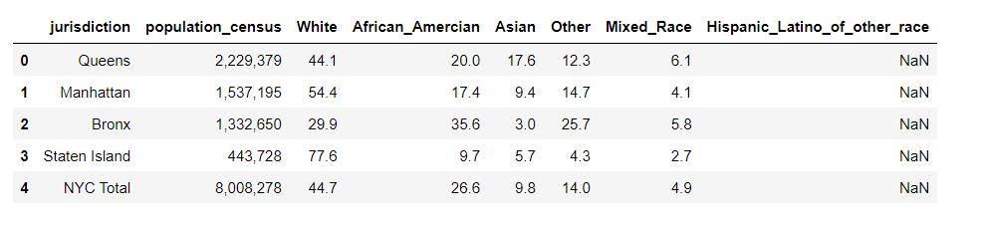
Finding the best restaurant
We get all the boroughs of New York City with their population, gdp per capita and person sqm.

Slide 5
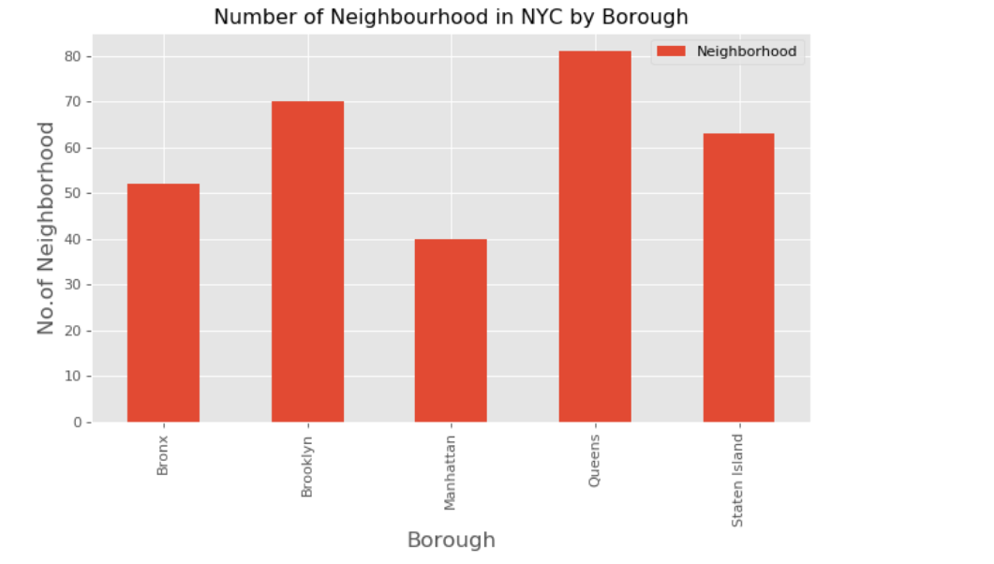
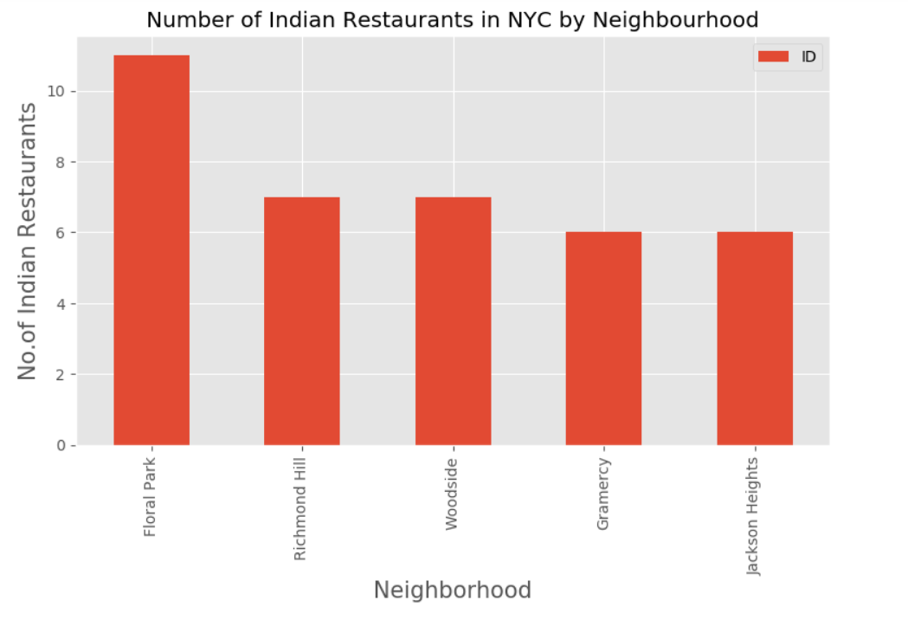
Finding the best restaurant
We use the Foursquare API to get the number of neighborhoods in NYC by Borough and Number of Indian restaurants in NYC by neighborhood

Slide 6
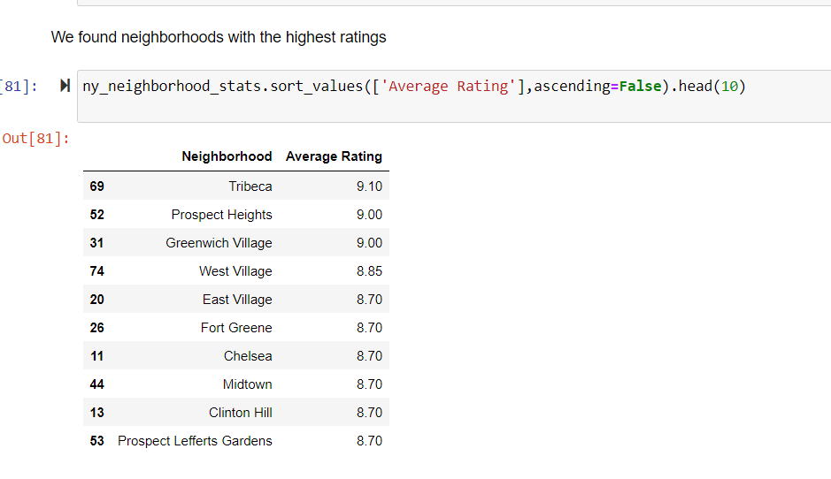
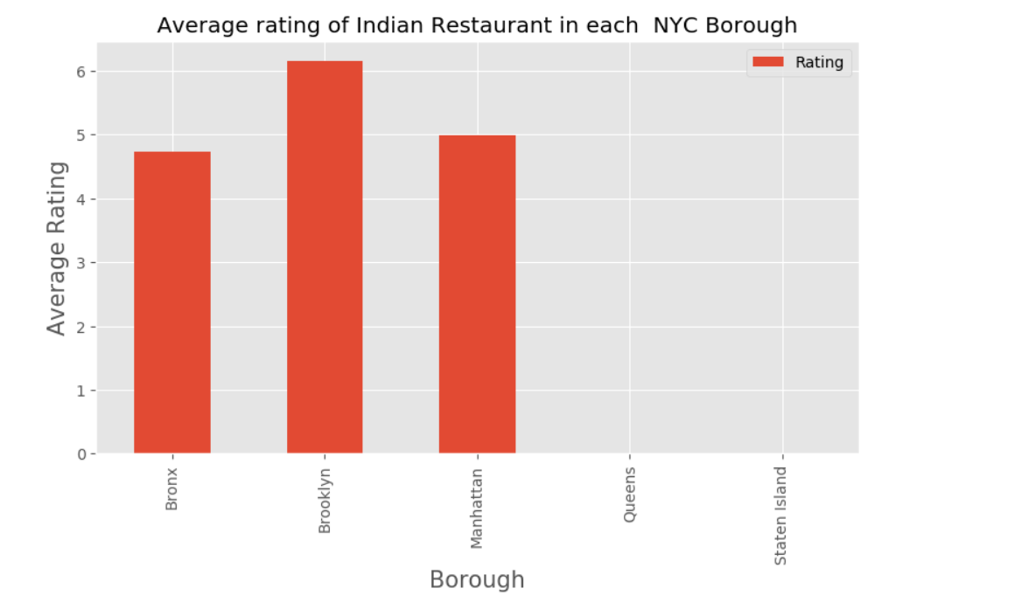
Finding the best restaurant

Slide 7
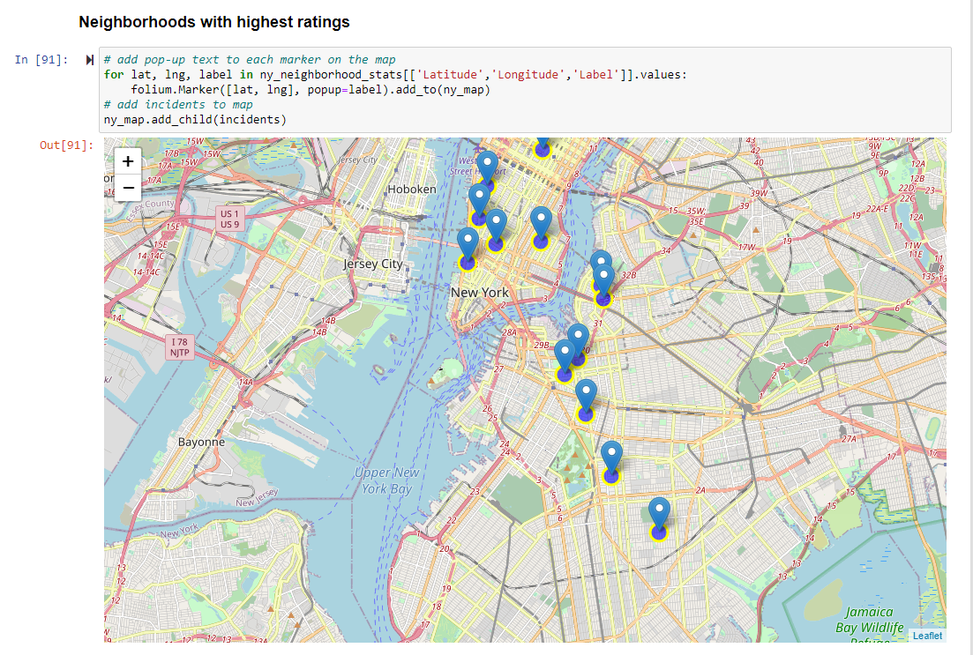
Finding in the restaurant
Neighborhoods with highest ratings in NYC visualized.

